Slide 1
Taking the Politics Out of a Pandemic
Kathryn Bondy

Slide 2
Project Scope
Is the pandemic really a “blue state problem”?
Percent Positivty Vs. Cumulative Cases
Red state Vs. Blue State Mask Requirements
50% more Red States than Blue States are over 10%
Earlier Months = Blue Today = Red
Red states were slower to enact policies
Red States are enacting similar policies now that the virus has spread

Slide 3
Percent Positivty Vs. Cumulative Cases
Later testing leads to lower cumulative cases
Needed the positive vs. negative cases per state
3% margin for false positives, source within 5% Confidence Interval
Utilized: CDC daily data of cases by state

Slide 4
Red State Vs. Blue State Mask Requirements
When did states enact mask requirements?
Do slower-to-react states have higher positivity rates?
Do Blue States and Red States have policies in place?
Utilized: New York Times Data

Slide 5
Data Clean Up
Positivity Rate
The data was presented as positive cases vs. negative cases, needed to be transformed to percent.
Contiguous US
Better picture of the spread as borders touch.
Geometry Merge
Geopandas uses geometry to map out the states. Merged the geometry of the states with corona cases.
Create Boolean Variables
Boolean variables for whether a state required masks and if it was a Blue State or Red State.
% Positive by Time
Broke down the positivity rate at different junctures to create a timelapse.
Mask Requirements
Broke down when states required masks at different junctures to create a timelapse.

Slide 6
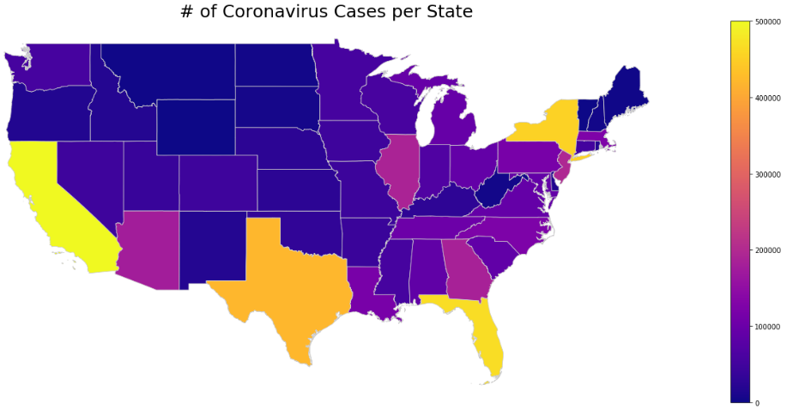
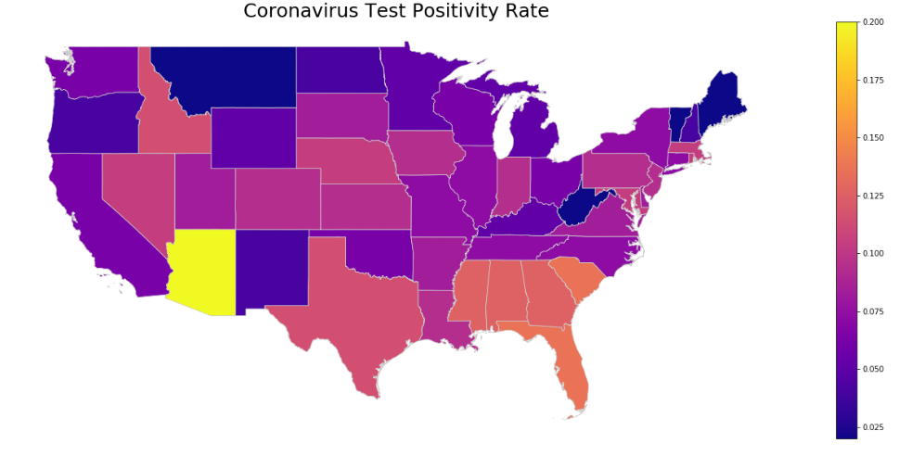
# of Coronavirus Cases per State Vs. Percent Positivity ps
This is the number being commonly presented - does not consider available tests, or spikes.
This number shows the actual growth in cases, and accounts for potential lack of available testing.

Slide 7
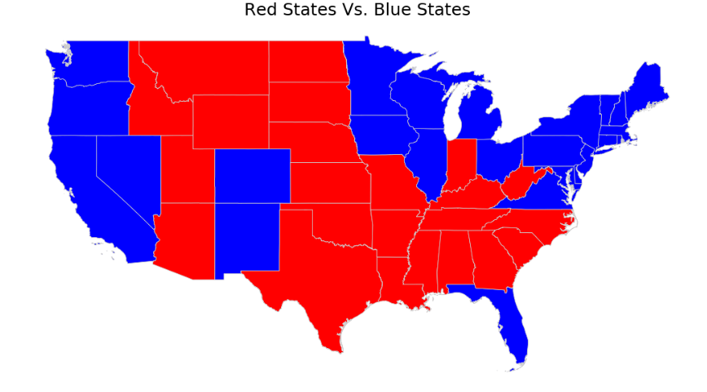
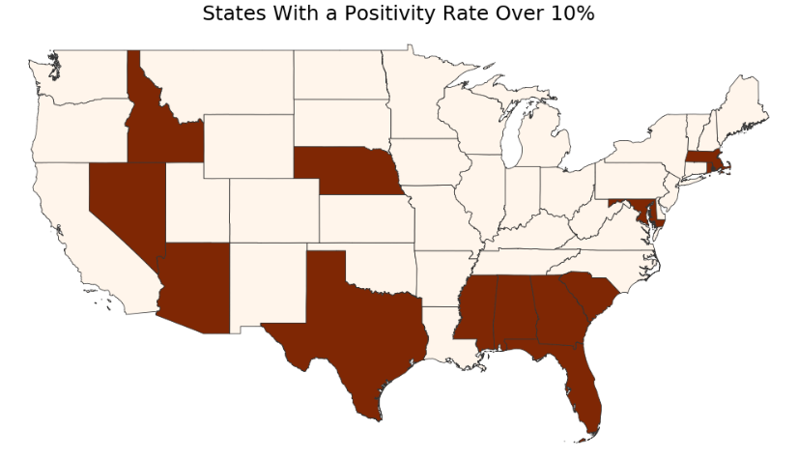
Red States Vs. Blue States Over 10% Positvity
Red States Vs. Blue States 2020
Whoa! That’s a big number, aren’t you proud?
8 Red States Over 10% Vs. 4 Blue States Over 10%

Slide 8
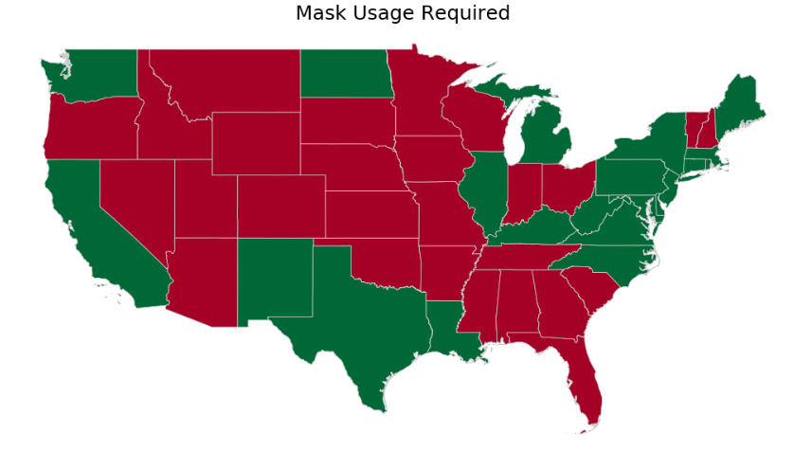
# of Coronavirus Cases per State Vs. Percent Positivity ps
Red States Vs. Blue States 2020
Mask usage as of July 15, 2020 now reflects a mix of Red State and Blue State requirements, however, there are still 50% more Blue States than Red States

Slide 9
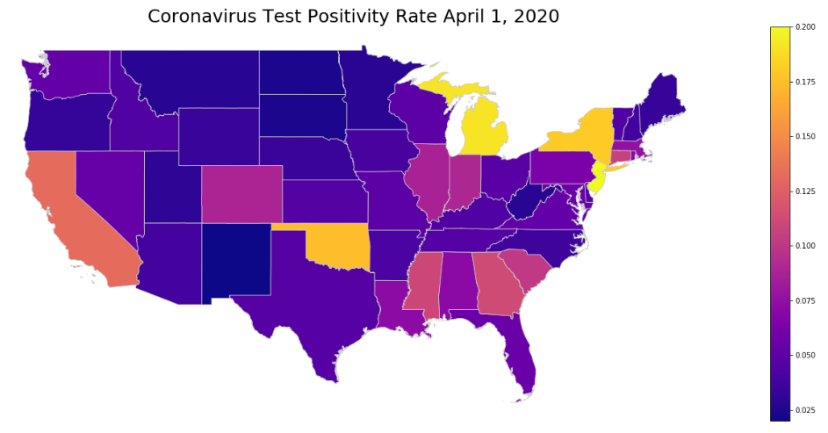
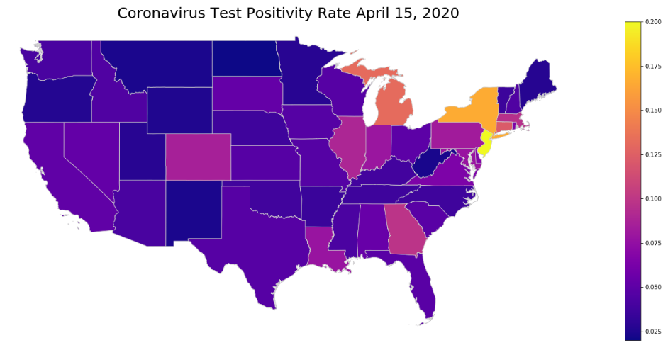
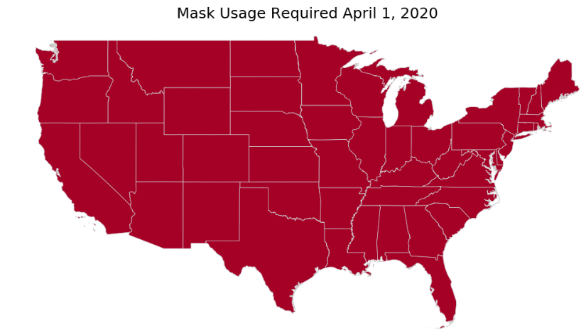
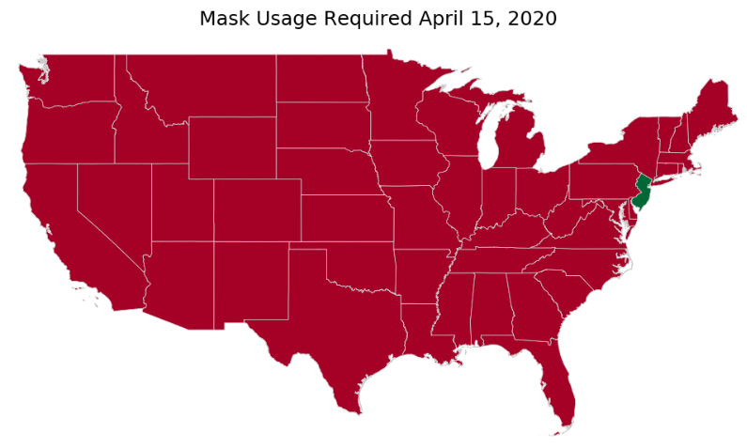
Time Lapse of Mask Usage and Percent Positivity
Whoa! That’s a big number, aren’t you proud?

Slide 10
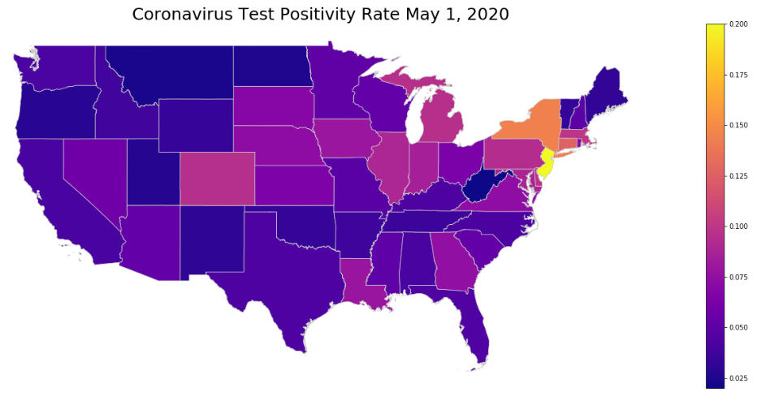
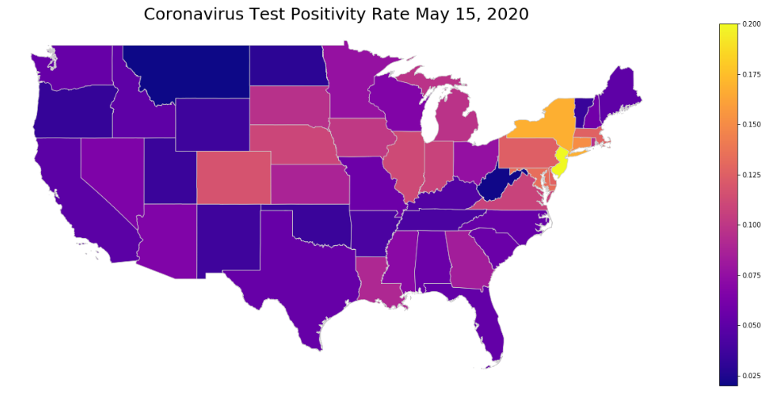
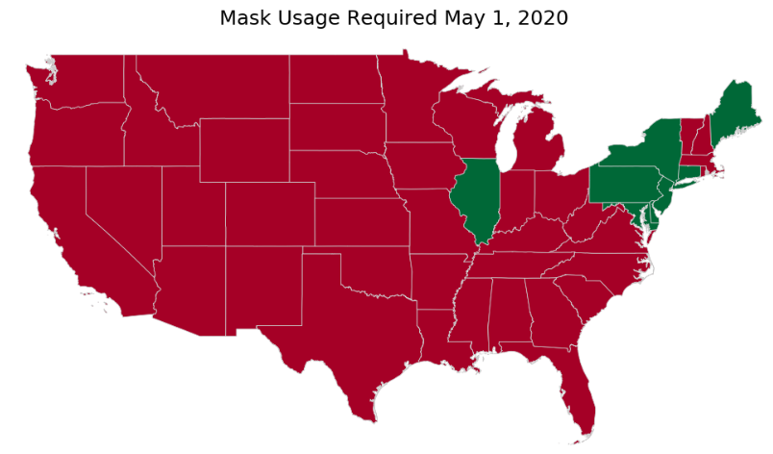
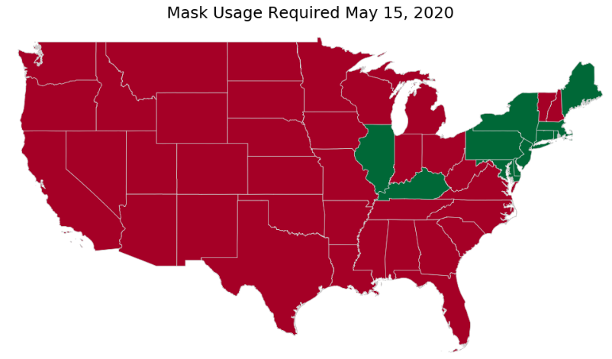
Time Lapse of Mask Usage and Percent Positivity
Whoa! That’s a big number, aren’t you proud?

Slide 11
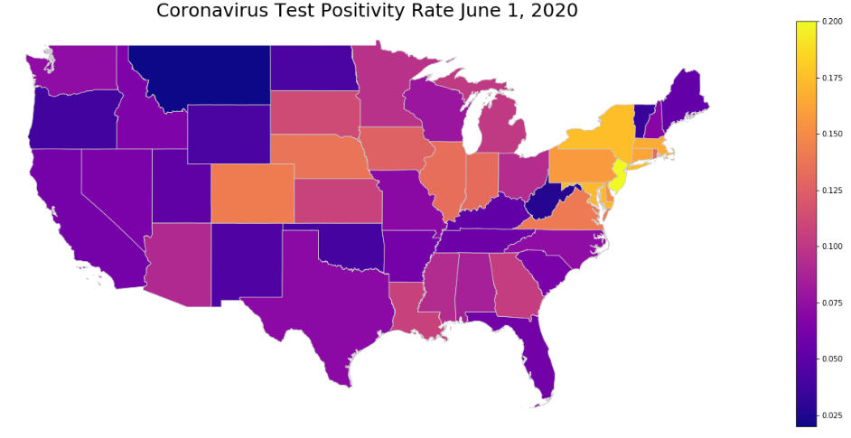
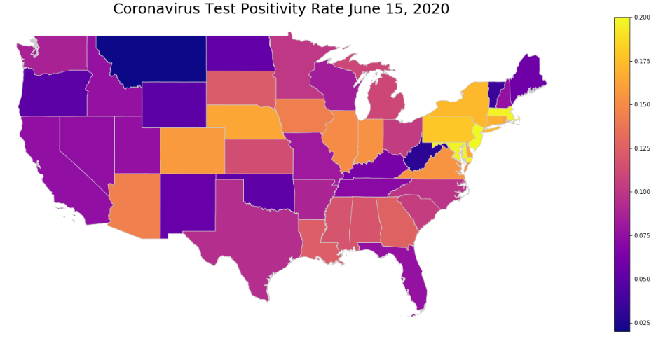
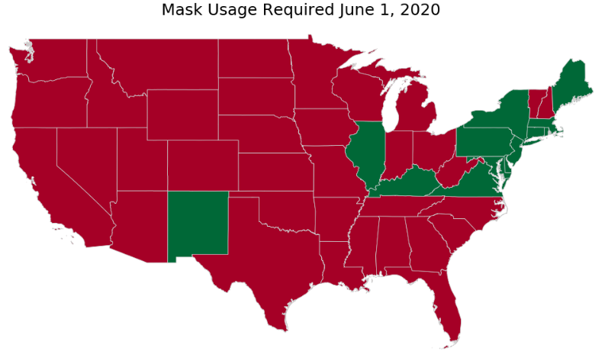
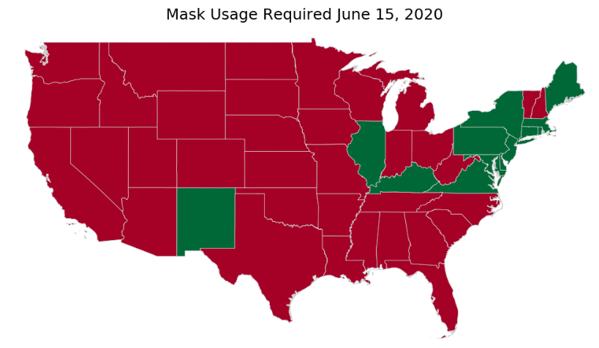
Time Lapse of Mask Usage and Percent Positivity
Whoa! That’s a big number, aren’t you proud?

Slide 12
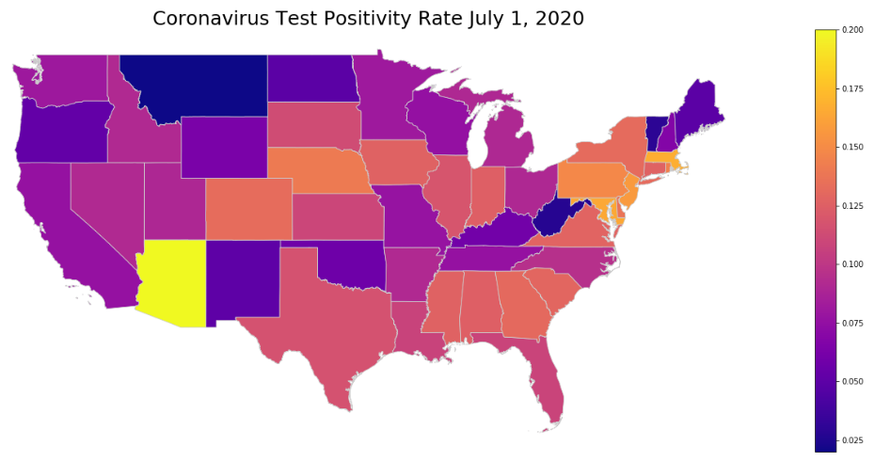
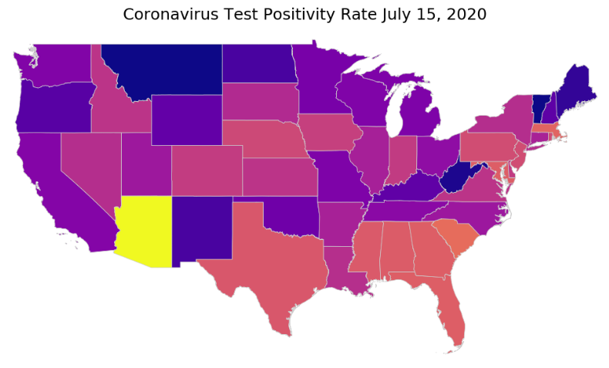

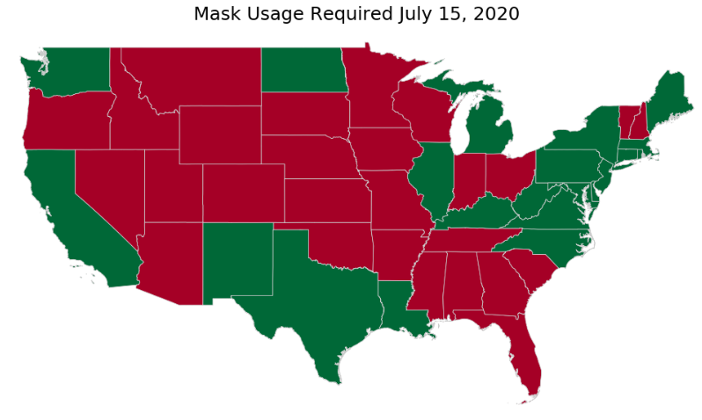
Time Lapse of Mask Usage and Percent Positivity
Whoa! That’s a big number, aren’t you proud?

Slide 13
Summary of Top 7 Percent Positivity Rates
 | Red State Vs. Blue State | Percent Positivity Rate | Masks Required
Arizona |  | 0.19
Florida |  | 0.13
South Carolina |  | 0.13
Alabama |  | 0.12
Georgia |  | 0.12
Mississippi |  | 0.12
Idaho |  | 0.11

Slide 14
Findings
Presentation of Data
Once you reorganize the data to showcase positivity rates vs. cumulative numbers [which adjust for population and testing availability], you see a very different picture.
Mask Requirements
States that lagged in mask requirements have seen increases in their numbers of cases. The states with the top rates do not require mask usage.
Conclusion: This pandemic is not a “Blue State” problem, and the data shows if anything it is the opposite. The cases have to do with policy and geographic spread, not with politics.

Slide 15
Reflection
Data
Difficult to find one source that shows all the relevant data. Data had to be pieced together from different sources.
Additional Questions
What is affecting this data other than mask requirements?
Compliance
Deaths
Beliefs
Continued Research
Many states have enacted mask requirements since July 15th – how will this affect the numbers?

Slide 16
Questions?

